Slide 1
Name – Vinit Rajendra Darade Mob. No. 9022077964 Topic name- Capstone Project Data Science with Python Career Program Course name - Data Science with Python Career Program

Slide 2
AGENDA :
INTRODUCTION
OBJECTIVE
MOTIVATION AND CHALLENGES
TECHNOLOGY USED
SYSTEM DESIGN
METHODOLOGY
EXPERIMENT AND RESULTS
DATA ANALYSIS IN EXCEL
CONCLUSION

Slide 3

INTRODUCTION
From a long time since being, a continuous paradigm of transactions of commodities has been into existence. Earlier these transactions were in the form of barter system which later was translated into a monetary system. And with consideration into these, all changes that were brought about the pattern of re- selling items was affected as well. There are two ways in which the re-selling of the item is carried out. One is oftline and the other being online.
In offline transactions, there is a mediator present in between who is very vulnerable to being corrupt and make overly profitable transactions. The second option is online wherein there is a certain platform which lets the user find the price he might get if he goes for selling.

Slide 4

OBJECTIVE
To build a supervised machine learning model for forecasting value of a vehicle based on multiple attributes.
The system that is being built must be feature based i.e., feature wise prediction must be possible.
Providing graphical comparisons to provide a better view.

Slide 5

MOTIVATION AND CHALLENGES
The automotive industry is composed of a few top global multinational players and several retailers. The multinational players are mainly manufacturers by trade whereas the retail market features players who deal in both new and used vehicles
The used car market has demonstrated a significant growth in value contributing to the larger share of the overall market. The used car market in India accounts for nearly 3.4 million vehicles per year.

Slide 6
TECHNOLOGY USED
Matplotlib
Matplotlib is especially deployed for basic plotting. Bars, pies, lines, scatter plots and so on are part of visualization using matplotlib. Matplotlib is a graphics package well integrated with NumPy and Pandas. The MATLAB plotting commands are closely mirrored by the pyplot module
Seaborn
Seaborn provides various visualization patterns. It has easy and interesting default themes and uses fewer syntax. Statistics visualization is the speciality of seaborn and it is employed while summarizing data in visuals and additionally depict the data distribution.

Slide 7
TECHNOLOGY USED
Linear Regression
Regression is a method for predicting a dependent component with the help of independent variables. The method is commonly used to predict and calculate correlations between independent and dependent variables. The regression model establishes a linear or exponential connection between independent and dependent variables.

Slide 8
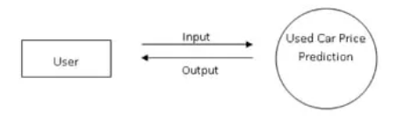
SYSTEM DESIGN
A data flow diagram shows the way information flows through a process or system. It includes data inputs and outputs data stores and the various sub processes the data moves through. DFDs are built using standardized symbols and notation to describe various entities and their relationships. In this project there is one DFD

Slide 9
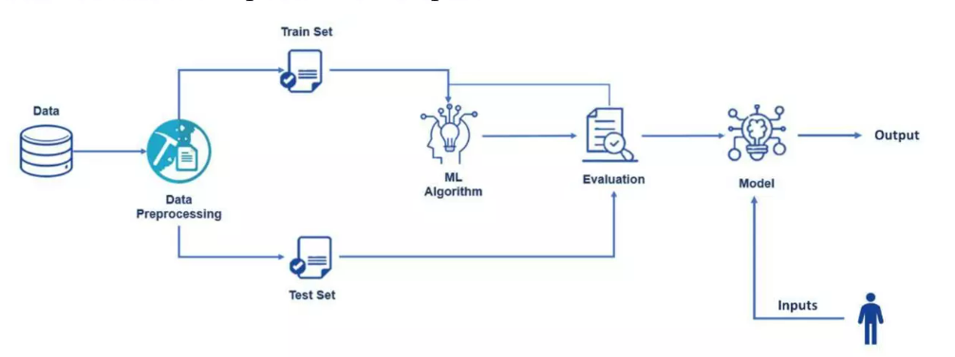
SYSTEM DESIGN
True data is noisy. Therefore, it is necessary to clean data so that the actual information from the collected data can be acquired. Different processes are carried out to obtain the actual information such as manual encoding and one hot encoding. Then feature extraction is performed to extract necessary features. Linear regression modelling is used to train the dataset. User can give an input to the detection model and it will provide an output.

Slide 10
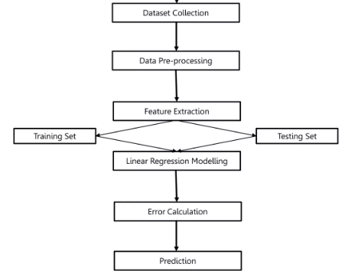
METHODOLOGY

Slide 11
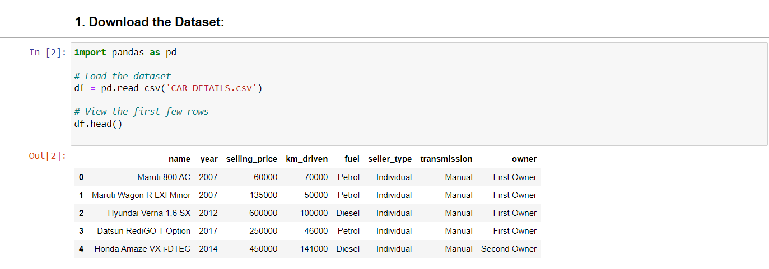
EXPERIMENT AND RESULTS
The dataset is imported and read for understanding

Slide 12
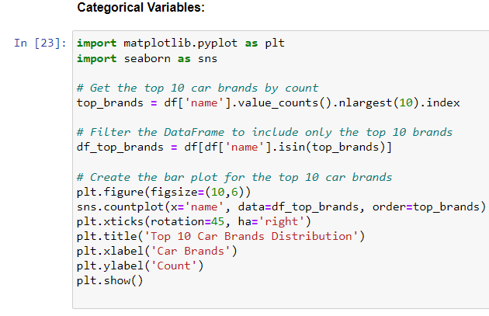
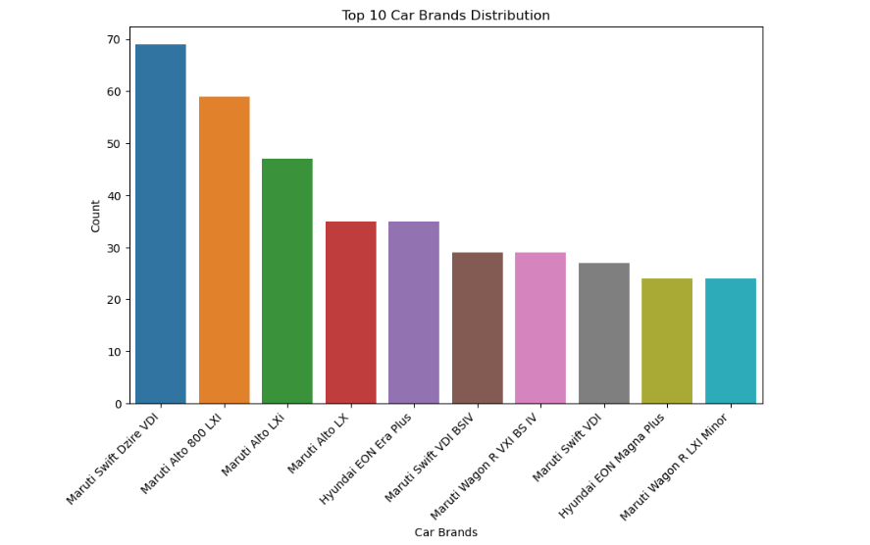
VISUALIZING CATEGORICAL DATA COLUMNS

Slide 13
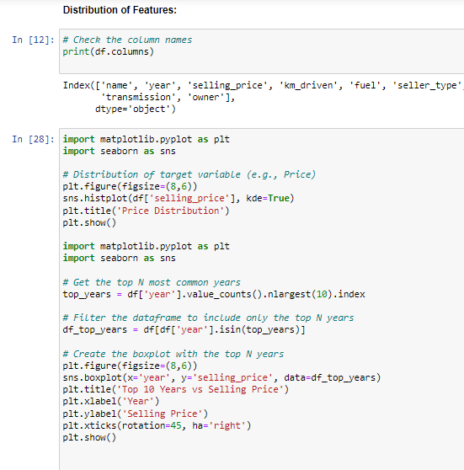
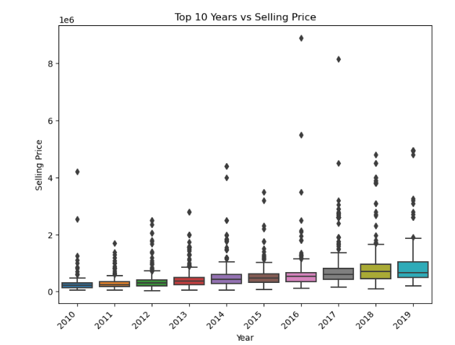
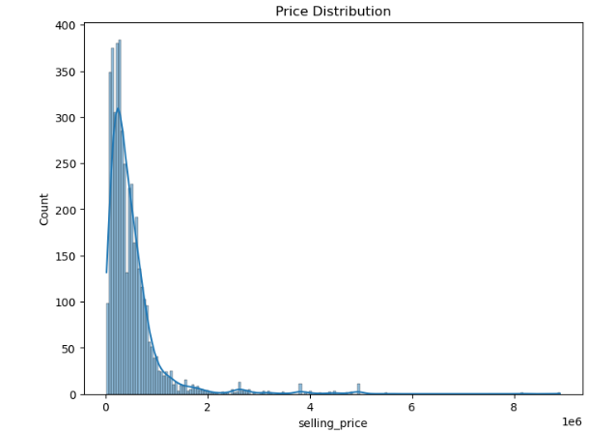
DISTRIBUTION OF FEATURES

Slide 14
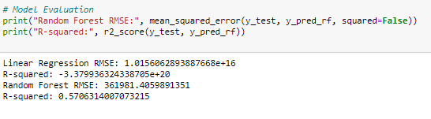
ERROR CALCULATION

Slide 15
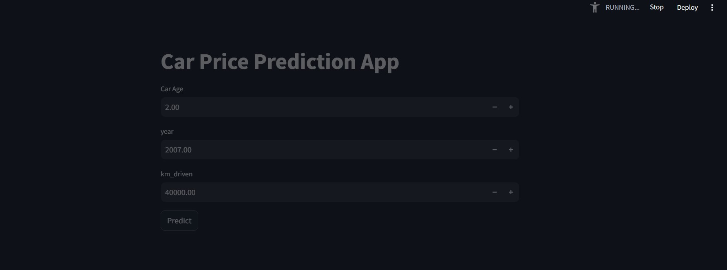
FINAL APP

Slide 16
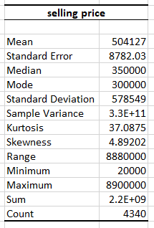
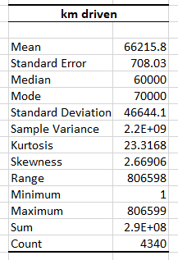
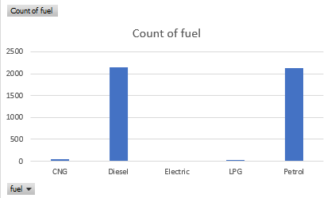
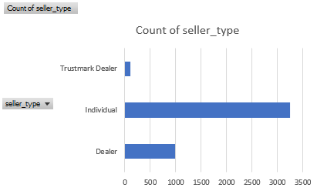
DATA ANALYSIS IN EXCEL

Slide 17
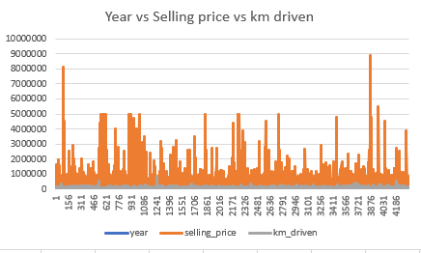
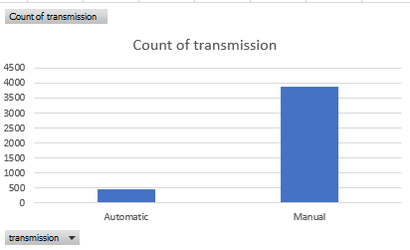
DATA ANALYSIS IN EXCEL

Slide 18
CONCLUSION
In this project, a Linear Regression Model was successfully implemented employing various prominent algorithms from the python libraries and modules.
After the collection of data was done, further processing of data was done. The null entries and missing datapoints were removed from the dataset and the categorical variables were also processed using One Hot Encoding technique.
The r2 score of Linear Regression was 0.86 which is good and predictions were quite close to the original selling prices.

Slide 19


